Slide 1
Artificial Intelligence
Dr. O. I. Adelaiye

Slide 2
Supervised Learning
Lecture 7

Slide 3
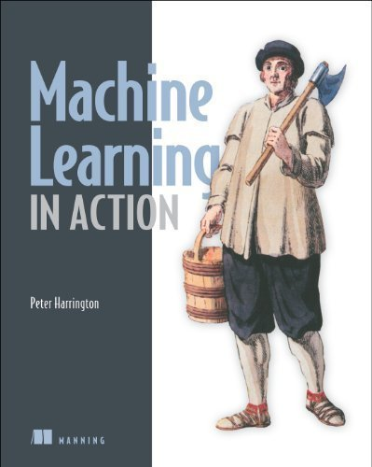

Slide 4
Introduction
Supervised Machine Learning algorithm can be broadly classified into Regression and Classification Algorithms.
In Regression algorithms, we can predicted the output for continuous values
In Classification algorithms, we can predict the categorical values.

Slide 5
Regression Analysis
Statistical method to model the relationship between a dependent (target) and (1 or more) independent (predictor) variables
It helps us to understand how the value of the dependent variable is changing corresponding to an independent variable when other independent variables are held fixed.
It predicts continuous/real values such as temperature, age, salary, price, weather, etc.

Slide 6
Regression Analysis
Example: Suppose there is a marketing company A, who does various advertisement every year and get sales on that. The list in the next slide shows the advertisement made by the company in the last 5 years and the corresponding sales. The company wants to know the sales with a $200 advertisement.

Slide 7
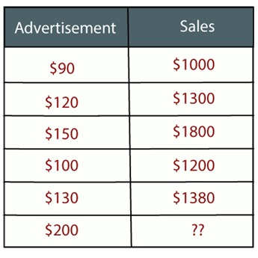
Regression Analysis

Slide 8
Terminologies
Dependent Variable: Main factor to predict or understand. It is also called target variable.
Independent Variable: Factor(s) which affect or which are used to predict the values of the dependent variables. It is also called as a predictor.
Outliers: An observation which contains either very low value or very high value in comparison to other observed values. May hamper final results and should be avoided.
Underfitting and Overfitting: If our algorithm works well with the training dataset but not well with test dataset, then such problem is called Overfitting. And if our algorithm does not perform well even with training dataset, then such problem is called underfitting.

Slide 9
Classification

Slide 10
Classification Algorithm
A Supervised Learning technique that is used to identify the category of new observations on the basis of training data.
A program learns from the given dataset or observations and then classifies new observation into a number of classes or groups.
Such as:
Yes or No, 0 or 1, Spam or Not Spam, cat or dog, malicious or normal, etc.
Classes can be called as targets/labels or categories

Slide 11
Classification Algorithm
Unlike regression, the output variable of Classification is a category, not a value, such as:
"Green or Blue", "fruit or animal", etc.
Since the Classification algorithm is a Supervised learning technique, hence it takes labeled input data, which means it contains input with the corresponding output.
In classification algorithm, a discrete output function(y) is mapped to input variable X

Slide 12
Classification Algorithm
y = f(x)
where y = categorical output

Slide 13
Types of ML Classification Algorithms
Linear Models
Logistic Regression
Support Vector Machines
Non-linear Models
K-Nearest Neighbours
Kernel SVM
Naïve Bayes
Decision Tree Classification
Random Forest Classification

Slide 14
Evaluating a Classification model
Once a model is completed, it is necessary to evaluate its performance. For evaluating a Classification model, we have the following ways:
Log Loss or Cross-Entropy Loss
Confusion Matrix
AUC - ROC

Slide 15
Log Loss or Cross-Entropy Loss
It is used for evaluating the performance of a classifier, whose output is a probability value between the 0 and 1.
For a good binary Classification model, the value of log loss should be near to 0.
The value of log loss increases if the predicted value deviates from the actual value.
The lower log loss represents the higher accuracy of the model.
For Binary classification, cross-entropy can be calculated as:
-(ylog(p)+(1-y)log(1-p))
Where y= Actual output, p= predicted output.

Slide 16
Confusion Matrix
The confusion matrix provides us a matrix/table as output and describes the performance of the model.
It is also known as the error matrix.
The matrix consists of predictions result in a summarized form, which has a total number of correct predictions and incorrect predictions. The matrix looks like as below table:

Slide 17

Confusion Matrix
 | Actual Positive | Actual Negative
Predicted Positive | True Positive | False Positive
Predicted Negative | False Negative | True Negative
Accuracy = $\frac{TP÷TN}{Total Population}$
TP = True Positive
TN = True Negative

Slide 18
AUC – ROC Curve
ROC curve stands for Receiver Operating Characteristics Curve and AUC stands for Area Under the Curve
It is a graph that shows the performance of the classification model at different thresholds
To visualize the performance of the multi-class classification model, we use the AUC-ROC Curve
The ROC curve is plotted with TPR and FPR, where TPR (True Positive Rate) on Y-axis and FPR(False Positive Rate) on X-axis

Slide 19
Application of Classification Models
Email Spam Detection
Speech Recognition
Identifications of Cancer tumor cells.
Drugs Classification
Biometric Identification
And many more

Slide 20
K Nearest Neighbor (KNN)

Slide 21
KNN
A simple conventional nonparametric (no assumption about the underlying distribution) technique for classification of datasets
This algorithm uses the assumption that similar things have close proximity to each other.
This ideology has been proven to have a high level of correctness as identified by the popularity and accuracy of the algorithm

Slide 22

KNN
This uses a graph to present distances between points generated from the dataset.
The most popular method for calculating distance between points is the Euclidean distance function
If i and j be the points the distance calculation will be:
$d\left(i,j\right)=\sqrt{(|x_{i1}−x_{j1}|^{2}+|x_{i2}−x_{j2}|^{2}+…+|x_{ip}−x_{jp}|^{2})}$

Slide 23

KNN
Other methods available for calculating distance for K Nearest Neighbour are:
Minkwoski function equation
$$d\left(i,j\right)=q\sqrt{(|x_{i1}−x_{j1}|^{q}+|x_{i2}−x_{j2}|^{q}+…+|x_{ip}−x_{jp}|^{q})}$$
Manhattan distance equation
$$d\left(i,j\right)=|x_{i1}−x_{j1}|+|x_{i2}−x_{j2}|+…+|x_{ip}−x_{jp}|$$

Slide 24
What’s K?
K is a parameter used in forming the groups
It is an important parameter in the success of the classification process.
This parameter determines the number of points in forming a group.
This value is provided during the training process

Slide 25
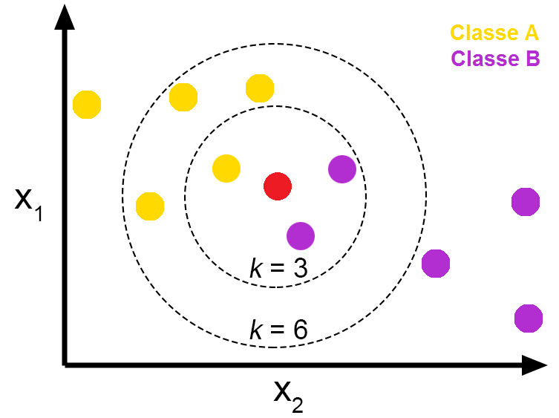

Slide 26
Implementing KNN

Slide 27
Dataset
The Iris dataset is readily available and the most famous sample data set for our KNN illustrations
The dataset consists of four attributes
Sepal-width
Sepal-length
Petal-width
Petal-length
These are the attributes of specific types of iris plant. The task is to predict the class to which these plants belong. There are three classes in the dataset:
Iris-setosa
Iris-versicolor
Iris-virginica

Slide 28
Importing Libraries
import numpy as np
import matplotlib.pyplot as plt
import pandas as pd

Slide 29
Import Dataset
url = "https://archive.ics.uci.edu/ml/machine-learning-databases/iris/iris.data"
# Assign colum names to the dataset
names = ['sepal-length', 'sepal-width', 'petal-length', 'petal-width', 'Class’]
# Read dataset to pandas dataframe
dataset = pd.read_csv(url, names=names)
OR
dataset = pd.read_csv(iris.csv, names=names)

Slide 30
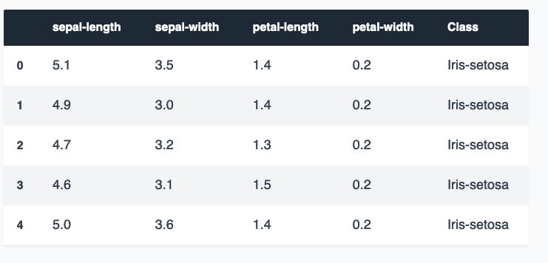
View Dataset
dataset.head()

Slide 31
Data Preprocessing
Separate database into its attributes and Labels
x = dataset.iloc[:, :-1].values
y = dataset.iloc[:, 4].values
Split training and testing data
from sklearn.model_selection import train_test_split X_train, X_test, y_train, y_test = train_test_split(X, y, test_size=0.20)

Slide 32
Feature Scaling
Scaling is done for uniformity of the features of the dataset
from sklearn.preprocessing import StandardScaler
scaler = StandardScaler()
scaler.fit(X_train)
X_train = scaler.transform(X_train)
X_test = scaler.transform(X_test)

Slide 33
Training and Prediction
Training the KNN algorithm
from sklearn.neighbors import KNeighborsClassifier classifier = KNeighborsClassifier(n_neighbors=5) classifier.fit(X_train, y_train)
Test/ Predict
y_pred = classifier.predict(X_test)

Slide 34
Evaluating Algorithm
from sklearn.metrics import classification_report, confusion_matrix
print(confusion_matrix(y_test, y_pred))
print(classification_report(y_test, y_pred))

Slide 35
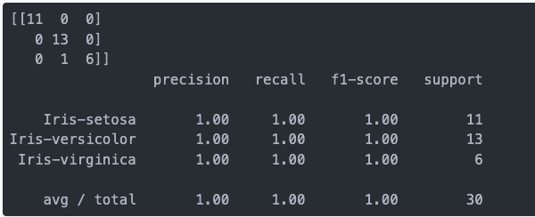

Slide 36


